Slide 1
W E L C O M E
to Creative Studio
This letterhead design is meant to project an image of professionalism and reliability. By using simple alignments we have created a very spacious feeling.
The layout, these basic qualities along with the (Your Company) colors, are consistent with the overall look and helps to reinforce the (Your Company) brand. This letterhead design is meant to project an image of professionalism and reliability.

Slide 2

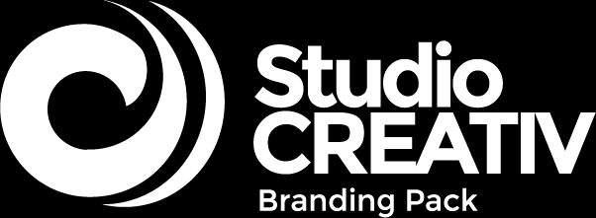
Creativity
This letterhead design is meant to project an image of profession and reliability. By using simple alignments we have created a very spacious feeling. The simplicity suggests strength and the spaciousness contribute.
COU AGE
TAKES
R
02

Slide 3
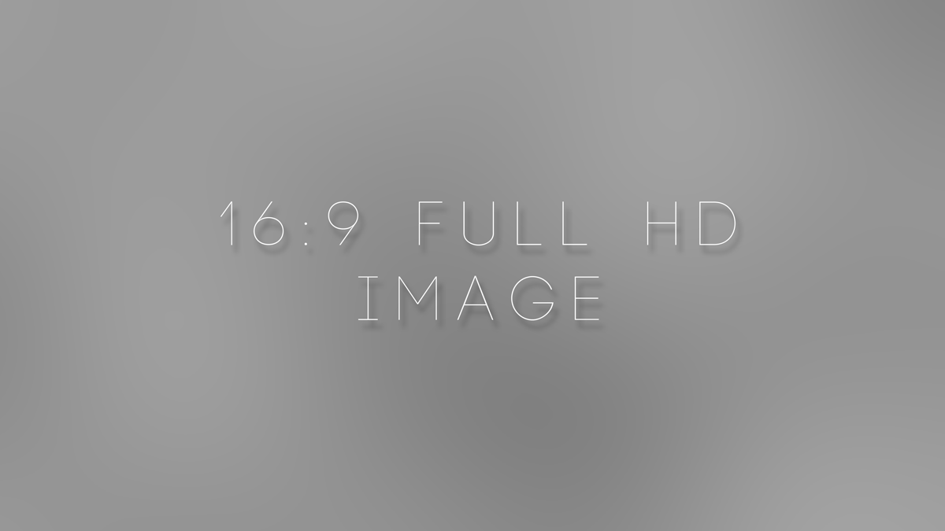
W E L C O M E
This letterhead design is meant to project an image of professionalism and reliability. By using simple alignments we have created a very spacious feeling. The simplicity suggests strength and the spaciousnes contributes to the aesthetics of the layout. These basic qualities along with the (Your Company) colours, are consistent with the overall look and helps to reinforce the (Your Company) brand. This letterhead design is meant to project an image of professionalism and reliability.
03

Slide 4

This letterhead design is meant to project an image of profession and reliability.
This letterhead design is meant to project an image of profession and reliability. By using simple alignments we have created a very spacious feeling. The simplicity suggests strength.
AWESOME HEADLINE TEXT
This letterhead design is meant to project an image of professionalism and reliability. By using simple alignments we have created a very spacious feeling. The simplicity suggests strength and the spaciousnes contributes to the aesthetics of the layout. These basic qualities along with the (Your Company) colours, are consistent with the overall look.
04

Slide 5
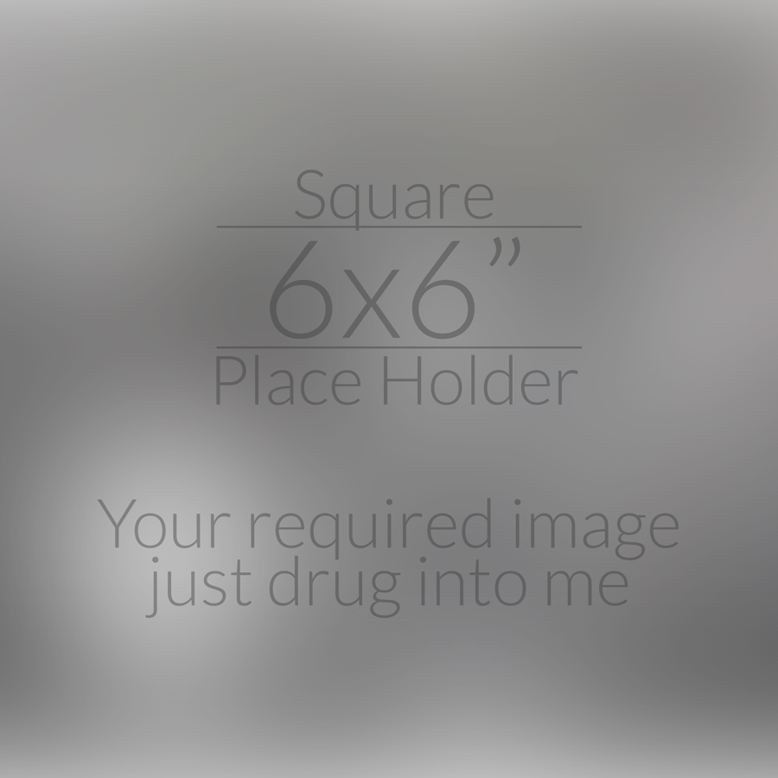
A B O U T U S
This letterhead design is meant to project an image of profession and reliability. By using simple alignments we have created a very spacious feeling. The simplicity suggests strength. This letterhead design is meant to project an image of profession.
This letterhead design is meant to project an image of professionalism and reliability. By using simple alignments we have created a very spacious feeling. The simplicity suggests strength and the spaciousnes contributes to the aesthetics of the layout. These basic qualities along with the (Your Company) colours, are consistent with the overall look and helps to reinforce the (Your Company) brand. This letterhead design is meant to project an image of professionalism.
This letterhead design is meant to project an image of professionalism and reliability. By using simple alignments we have created a very spacious feeling. The simplicity suggests strength and the spaciousn contributes to the aesthetics of the layout.
05

Slide 6
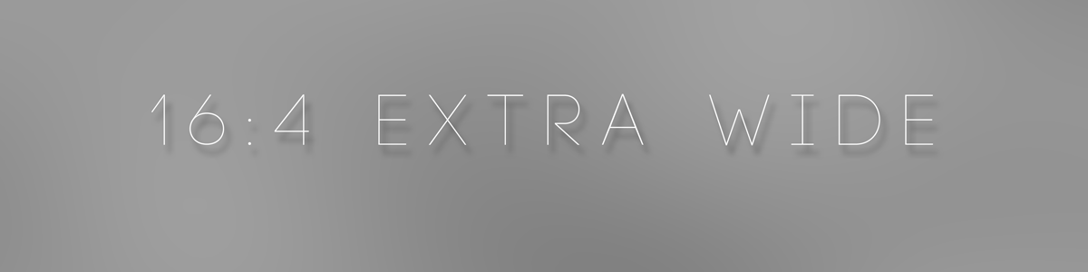



A B O U T U S
This letterhead design is meant to project an image of professionalism and reliability. By using simple alignments we have created a very spacious feeling. The simplicity suggests strength and the spaciousnes contributes to the aesthetics of the layout. These basic qualities along with the (Your Company) colours,
Letterhead design ismeant to project an image of profession
Letterhead design ismeant to project an image of profession
Letterhead design ismeant to project an image of profession
This letterhead design is meant to project an image of professionalism and reliability. By using simple alignment we have created a very spacious feeling. The simplicity.
This letterhead design is meant to project an image of professionalism and reliability. By using simple alignment we have created a very spacious feeling. The simplicity.
This letterhead design is meant to project an image of professionalism and reliability. By using simple alignment we have created a very spacious feeling. The simplicity.
06

Slide 7
W H O W E A R E
This letterhead design is meant to project an image of professionalism and reliability. By using simple alignments we have created a very spacious feeling. The simplicity suggests strength and the spaciousnes contributes to the aesthetics of the layout. These basic qualities along with the (Your Company) colours,
07

Slide 8
E X E C U T I V E T E A M
This letterhead design is meant to project an image of professionalism and reliability. By using simple alignments we have created a very spacious feeling. The simplicity suggests strength and the spaciousnes contributes to the aesthetics of the layout. These basic qualities along with the (Your Company) colours,
01
Chief
EXECUTIVE
OFFICER
This letterhead design is meant to project an image of professional and reliability.
02
JOHN
DOE
MARIE WEEKLE
DIRECTOR
03
Senior
EXECUTIVE
OFFICER
This letterhead design is meant to project an image of professional and reliability.
ROSEY MIKE
This letterhead design is meant to project an image of professional and reliability.
04
MICHEL HUSSY
Chief
OPERATING OFFICER
This letterhead design is meant to project an image of professional and reliability.
08

Slide 9
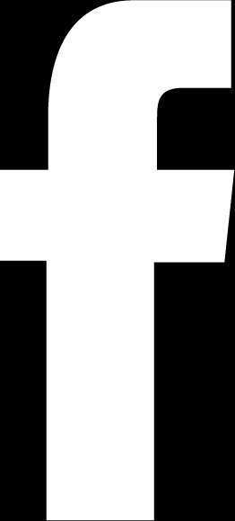
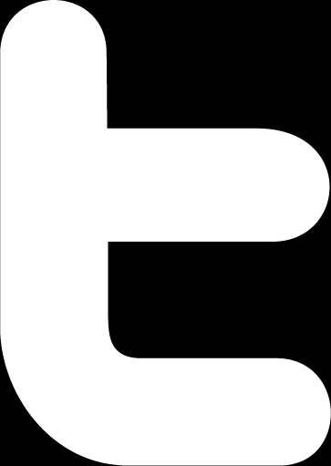
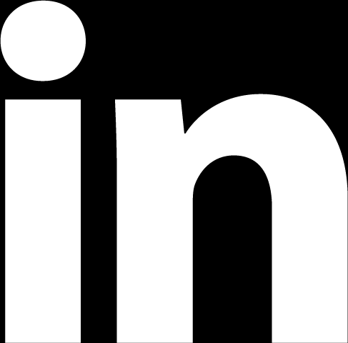
C R E A T I V E T E A M
JOHN DOE
ROSEY MIKE
This letterhead design is meant to project an image of professional and reliability. By using simple alignments we have created a very spacious feeling. The simplicity suggests.
spaciousnes contribut to the aesthetics of the layout. These basic qualities along with the (Your Company) colours,
Chief Designer
Artist
This letterhead design is meant to project an image of profession and reliability This letterhead.
This letterhead design is meant to project an image of profession and reliability This letterhead.
Working Skills:
Working Skills:
Ai
PSD
HTML
PHP
WP
Ai
PSD
HTML
PHP
WP
@idnamehere
@idnamehere
@idnamehere
@idnamehere
@idnamehere
@idnamehere
09

Slide 10
C R E A T I V E T E A M 2
This letterhead design is meant to project an image of professionalism and reliability. By using simple alignments we have created a very spacious feeling. The simplicity suggests strength and the spaciousness contributes to the aesthetics of the layout. These basic qualities along with the (Your Company) colours,
JOHN DOE
ROSEY MIKE
JOHNSON BIE
MARIE WEEKLE
Web Developer
Web Developer
Graphic Designer
Graphic Designer
This letterhead design is meant to project an image of profession and reliability This letterhead this letterhead design. This letterhead design is meant to project an imag.
This letterhead design is meant to project an image of profession and reliability This letterhead this letterhead design. This letterhead design is meant to project an imag.
This letterhead design is meant to project an image of profession and reliability This letterhead this letterhead design. This letterhead design is meant to project an imag.
This letterhead design is meant to project an image of profession and reliability This letterhead this letterhead design. This letterhead design is meant to project an imag.
10

Slide 11
T E A M S I N G L E
This letterhead design is meant to project an image of professionalism and reliability. By using simple alignments we have created a very spacious feeling. The simplicity suggests strength and the spaciousnes contributes to the aesthetics of the layout. These basic qualities along with the (Your Company) colours,
MARIE WEEKLE
Short Profile:
This letterhead design is meant to project an image of professionalism and reliability. By using simple alignments we have created a very spacious feeling. The simplicity suggests strength and the spaciousnes contributes to the aesthetics of the layout. These basic qualities along with the (Your Company) colours,
Chief
EXECUTIVE
OFFICER
This letterhead design is meant to project an image of professionalism and reliability. By using simple alignments we have created a very spacious feeling.
Working Skills:
Ai
PSD
HTML
PHP
WP
@idnamehere
@idnamehere
@idnamehere
11

Slide 12

O U R C R E A T I V E
S E R V I C E S
This letterhead design is meant to project an image of professionalism and reliability. By using simple alignments we have created a very spacious feeling. The simplicity suggests strength and the spaciousnes contributes to the aesthetics of the layout. These basic qualities along with the (Your Company) colours,
12

Slide 13
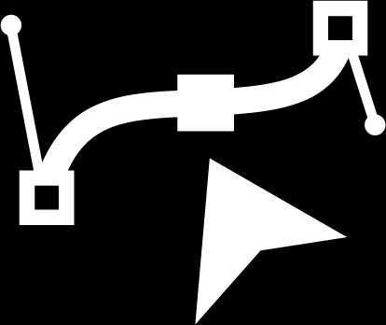
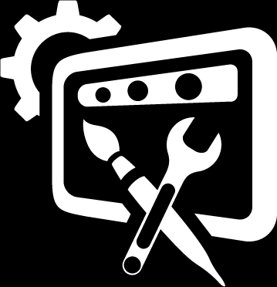
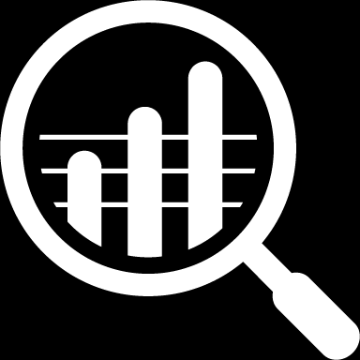
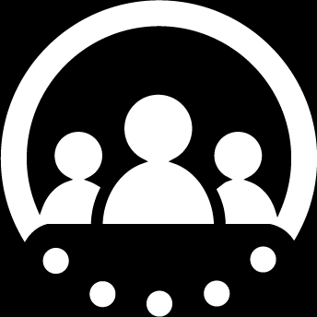
C R E A T I V E S E R V I C E S
This letterhead design is meant to project an image of professionalism and reliability. By using simple alignments we have created a very spacious feeling. The simplicity suggests strength and the spaciousnes contributes to the aesthetics of the layout. These basic qualities along with the (Your Company) colours,
GRAPHIC DESIGN
WEB DEVELOPMENT
SEARCH ENG. OPT.
SOCIAL MEDIA
SERVICE DETAILS HERE
SERVICE DETAILS HERE
SERVICE DETAILS HERE
SERVICE DETAILS HERE
This letterhead design is meant to project an image of professionalism and reliability. By using simple alignments we have created a very.
This letterhead design is meant to project an image of professionalism and reliability. By using simple alignments we have created a very.
This letterhead design is meant to project an image of professionalism and reliability. By using simple alignments we have created a very spacio
This letterhead design is meant to project an image of professionalism and reliability. By using simple alignments we have created.
13

Slide 14
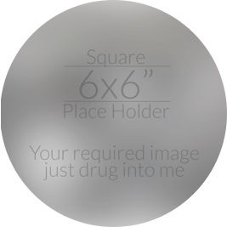
C R E A T I V E S E R V I C E S
This letterhead design is meant to project an image of professionalism and reliability. By using simple alignments we have created a very spacious feeling. The simplicity suggests strength and the spaciousnes contributes to the aesthetics of the layout. These basic qualities along with the (Your Company) colours,
GRAPHIC DESIGN
WEB DEVELOPMENT
GRAPHIC DESIGN
This letterhead design is meant to project an image of professionalism and reliability. By using simple alignments we have created a very.
This letterhead design is meant to project an image of professionalism and reliability. By using simple alignments we have created a very.
This letterhead design is meant to project an image of professionalism and reliability. By using simple alignments we have created a very.
14

Slide 15
C R E A T I V E S E R V I C E S
This letterhead design is meant to project an image of professionalism and reliability. By using simple alignments we have created a very spacious feeling. The simplicity suggests strength and the spaciousnes contributes to the aesthetics of the layout. These basic qualities along with the (Your Company) colours,
1
SERVICE DETAILS HERE
2
SERVICE DETAILS HERE
3
SERVICE DETAILS HERE
This letterhead design is meant to project an image of professionalism and reliability. By using simple alignments we have created.
This letterhead design is meant to project an image of professionalism and reliability.
This letterhead design is meant to project an image of professionalism and reliability. By using simple alignments we have created.
This letterhead design is meant to project an image of professionalism and reliability.
This letterhead design is meant to project an image of professionalism and reliability. By using simple alignments we have created.
This letterhead design is meant to project an image of professionalism and reliability.
15

Slide 16
O U R
P O R T F O L I O
This letterhead design is meant to project an image of professionalism and reliability. By using simple alignments we have created a very spacious feeling. The simplicity suggests strength and the spaciousnes contributes to the aesthetics of the layout. These basic qualities along with the (Your Company) colours,
16

Slide 17
P O R T F O L I O
This letterhead design is meant to project an image of professionalism and reliability. By using simple alignments we have created a very spacious feeling. The simplicity suggests strength and the spaciousnes contributes to the aesthetics of the layout. These basic qualities along with the (Your Company) colours,
1
This letterhead design is meant to project an image of professionalism and reliability. By using simple.
2
This letterhead design is meant to project an image of professionalism and reliability. By using simple.
3
This letterhead design is meant to project an image of professionalism and reliability. By using simple.
Yes!
WE HAVE SOME BETTER
This letterhead design is meant to project an image of professionalism and reliability. By using simple.
4
17

Slide 18
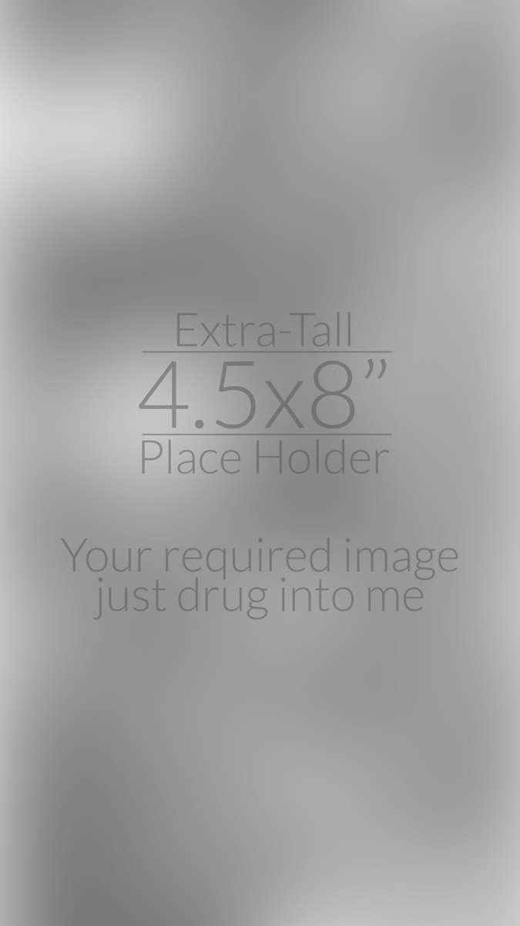
P O R T F O L I O
This letterhead design is meant to project an image of professionalism and reliability. By using simple alignments we have created a very spacious feeling. The simplicity suggests strength and the spaciousnes contributes to the aesthetics of the layout. These basic qualities along with the (Your Company) colours,
1
ITEM HEADING GOES HERE
This letterhead design is meant to project an image of professionalis and reliability.
ITEM HEADING GOES HERE
3
ITEM HEADING GOES HERE
2
This letterhead design is meant to project an image of professionalis and reliability.
This letterhead design is meant to project an image of professionalis and reliability.
18

Slide 19
P O R T F O L I O
This letterhead design is meant to project an image of professionalism and reliability. By using simple alignments we have created a very spacious feeling. The simplicity suggests strength and the spaciousnes contributes to the aesthetics of the layout. These basic qualities along with the (Your Company) colours,
This letterhead design is meant to project an image of professional and reliability.
This letterhead design is meant to project an image of professional and reliability.
This letterhead design is meant to project an image of professional and reliability.
This letterhead design is meant to project an image of professional and reliability.
19

Slide 20
PAGE
BREAK
This letterhead design is meant to project an image of professionalism and reliability. By using simple alignments we have created a very spacious feeling. The simplicity suggests strength and the spaciousnes contributes to the aesthetics of the layout. These basic qualities along with the (Your Company) colours,
20

Slide 21
H I S T O R Y
O F C O M P A N Y
This letterhead design is meant to project an image of professionalism and reliability. By using simple alignments we have created a very spacious feeling. The simplicity suggests strength and the spaciousnes contributes to the aesthetics of the layout. These basic qualities along with the (Your Company) colours, are consistent with the overall look and helps to reinforce the brand.
This letterhead design is meant to project an image of professiona.
21

Slide 22
C O M P A N Y H I S T O R Y
This letterhead design is meant to project an image of professionalism and reliability. By using simple alignments we have created a very spacious feeling. The simplicity suggests strength and the spaciousnes contributes to the aesthetics of the layout. These basic qualities along with the (Your Company) colours,
This letterhead design is meant to project an image of professionalism and reliability. By using simple alignments we have created a very spacious feeling. The simplicity suggests strength and the spaciousnes contributes to the aesthetics of the layout. These basic qualities along with the (Your Company) colours, are consistent with the overall look and helps to reinforce the brand.
This letterhead design is meant to project an image of professionalism and reliability. By using simple alignments we have created a very spacious feeling.
This letterhead design is meant to project an image of professionalism and reliability. By using simple.
Yes!
WE HAVE SOME BETTER
1
Letterhead
Design
Project
Letterhead
Design
Project
Letterhead
Design
Project
This letterhead design is meant to project an image of professionalism and reliability. By using simple.
2
This letterhead design is meant to project an image of professionalism and reliability. By using simple.
3
22

Slide 23
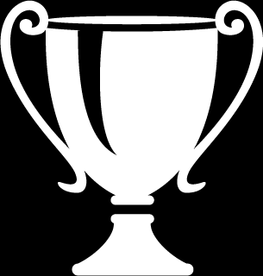
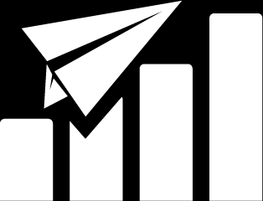

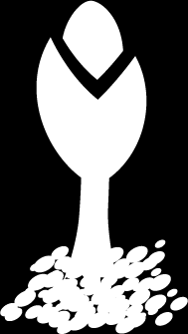
T I M E L I N E
This letterhead design is meant to project an image of professionalism and reliability. By using simple alignments we have created a very spacious feeling. The simplicity suggests strength.
2010, OCT
2010, JAN
By using simple alignment we have create a very spacious feeling. The simplicity.
By using simple alignment we have create a very spacious feeling. The simplicity.
FIRST AWARD
TRENDING MORE
OFFICIALLY LAUNCHED
2014, FEB
By using simple alignment we have create a very spacious feeling. The simplicity.
COMPANY
BORN
2013, AUG
By using simple alignment we have create a very spacious feeling.
23

Slide 24
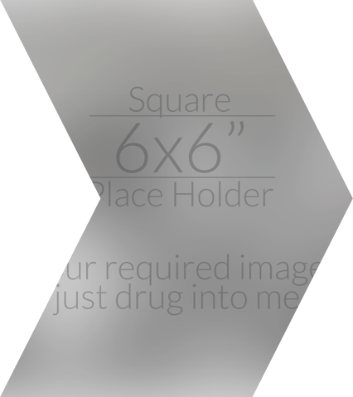
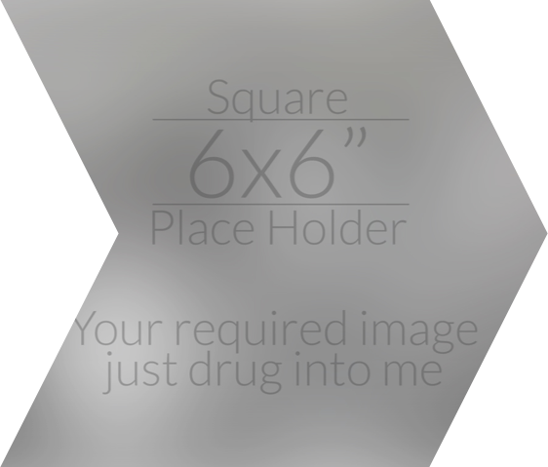
V I S I O N / M I S S I O N
This letterhead design is meant to project an image of professionalism and reliability. By using simple alignments we have created a very spacious feeling. The simplicity suggests strength and the spaciousnes contributes to the aesthetics of the layout. These basic qualities along with the (Your Company) colours,
EXTRA HEADING FOR THIS TEXT AS EXAMPLE
This letterhead design is meant to project an image of professionalism and reliability. By using simple alignments we have created a very spacious feeling. The simplicity suggests strength.
WE TAKE THE BETTER ACTIONS FOR GREEN LIFE AT ALL
This letterhead design is meant to project an image of professionalism and reliability. By using simple alignments we have created a very spacious feeling. The simplicity suggests strength and the spaciousnes contributes to the aesthetics of the layout. These basic qualities along with the (Your Company) colours, are consistent with the overall look and helps to reinforce the brand.
This letterhead design is meant to project an image of professionalism and reliability. By using simple alignments.
24

Slide 25
P A S T R E P O R T S
This letterhead design is meant to project an image of professionalism and reliability. By using simple alignments we have created a very spacious feeling. The simplicity suggests strength and the spaciousnes contributes to the aesthetics of the layout. These basic qualities along with the (Your Company) colours, are consistent with the overall look and helps to reinforce the (Your Company) brand. This letterhead design is meant to project an image of professionalism and reliability.
This letterhead design is meant to project an image of professionalism and reliability. By using simple alignments we have created a very spacious feeling.
25

Slide 26
P A S T R E P O R T S
This letterhead design is meant to project an image of professionalism and reliability. By using simple alignments we have created a very spacious feeling. The simplicity suggests strength and the spaciousnes contributes to the aesthetics of the layout. These basic qualities along with the (Your Company) colours,
T O T A L G R O W T H
10
YEARS
AFTER
76%
This letterhead design is meant to project an image of professionalism and reliability. By using simple alignments we have created a very spacious feeling.
15%
at 2008
25%
at 2009
45%
at 2010
35%
at 2011
65%
at 2012
55%
at 2013
This letterhead design is meant to project an image of professional and reliability. By using simple alignments we have created a very.
8%
This letterhead design is meant to project an image of eliabili.
This letterhead design is meant to project an image of eliabili.
This letterhead design is meant to project an image of eliabili.
This letterhead design is meant to project an image of eliabili.
This letterhead design is meant to project an image of eliabili.
This letterhead design is meant to project an image of eliabili.
26

Slide 27

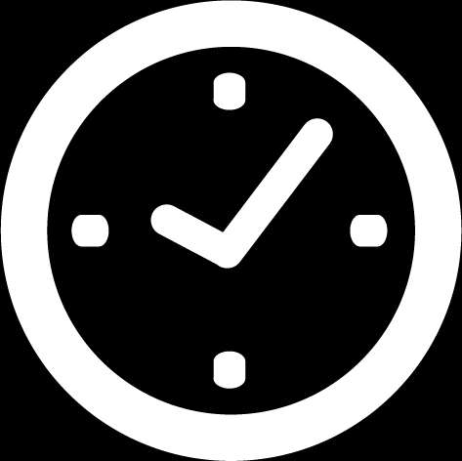


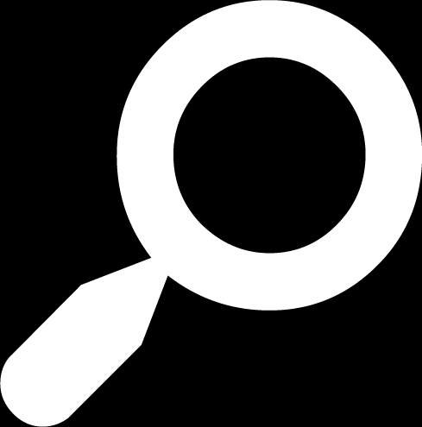


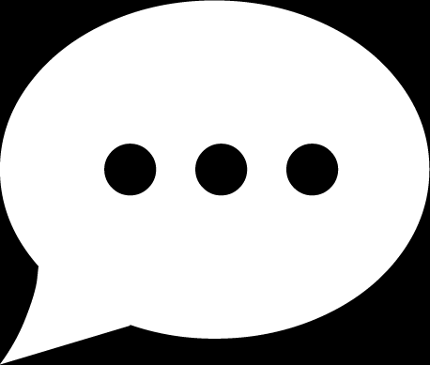
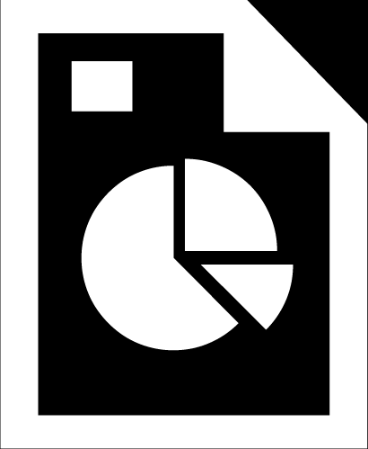
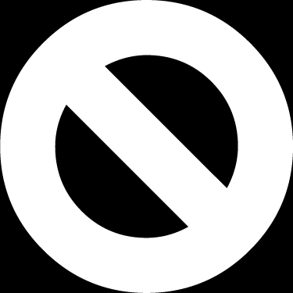
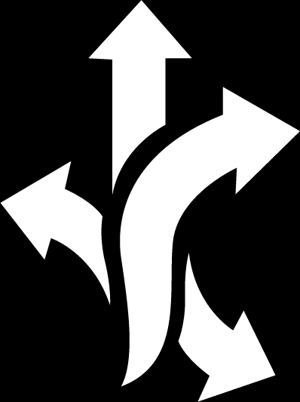

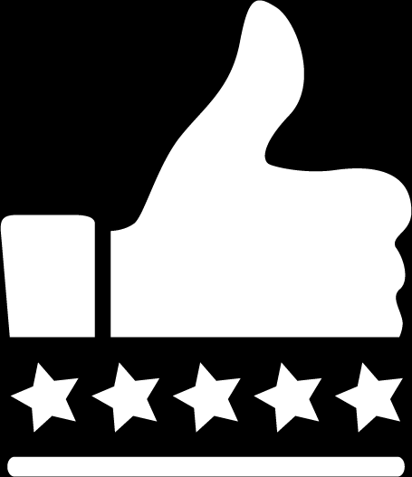
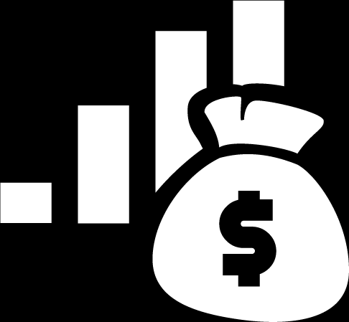
P A S T R E P O R T S
This letterhead design is meant to project an image of professionalism and reliability. By using simple alignments we have created a very spacious feeling. The simplicity suggests strength and the spaciousnes contributes to the aesthetics of the layout. These basic qualities along with the (Your Company) colours,
FACT ONE
FACT TWO
FACT THREE
FACT FOUR
FACT FIVE
This letterhead design is meant to project.
This letterhead design is meant to project.
This letterhead design is meant to project.
This letterhead design is meant to project.
This letterhead design is meant to project.
Yes!
WE HAVE SOME BETTER
FACT SIX
FACT SEVEN
FACT EIGHT
FACT NINE
This letterhead design is meant to project.
This letterhead design is meant to project.
This letterhead design is meant to project.
This letterhead design is meant to project.
This letterhead design is meant to project an image of professionalism and reliability. By using simple alignments we have created a very spacious feeling. The simplicity suggests strength and the spaciousnes contributes to the aesthetics of the layout. These basic qualities.
FACT TEN
ELEVEN FACT
TWELVE FACT
FACT THIRTN
FOURTEEN
This letterhead design is meant to project.
This letterhead design is meant to project.
This letterhead design is meant to project.
This letterhead design is meant to project.
This letterhead design is meant to project.
27

Slide 28
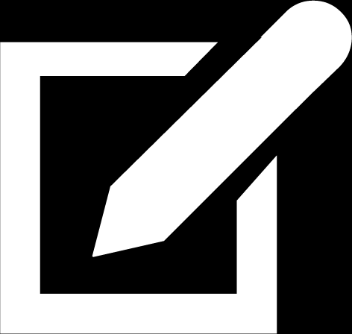
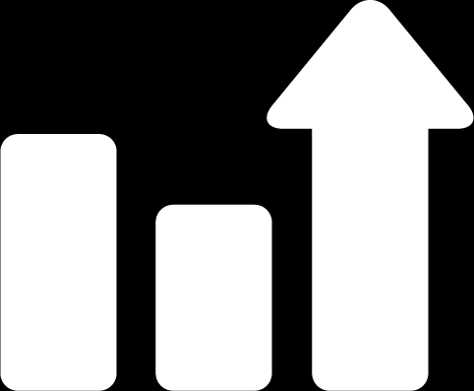
P A S T R E P O R T S
This letterhead design is meant to project an image of professionalism and reliability. By using simple alignments we have created a very spacious feeling. The simplicity suggests strength and the spaciousnes contributes to the aesthetics of the layout. These basic qualities along with the (Your Company) colours,
FACT ONE
SECOND FACT
THIRD FACT
This letterhead design is meant to project an image of professionalism and reliability. By using simple alignments we have created.
This letterhead design is meant to project an image of professionalism and reliability. By using simple alignments we have created.
This letterhead design is meant to project an image of professionalism and reliability. By using simple alignments we have created.
HEADLINE TEXT HERE
HEADLINE TEXT HERE
HEADLINE TEXT HERE
This letterhead design is meant
Project an image of professionalism
Alignments we have created
This letterhead design is meant
This letterhead design is meant
Project an image of professionalism
Alignments we have created
This letterhead design is meant
This letterhead design is meant
Project an image of professionalism
Alignments we have created
This letterhead design is meant
28

Slide 29
S T A T U S
A T P R E S E N T
This letterhead design is meant to project an image of professionalism and reliability. By using simple alignments we have created a very spacious feeling. The simplicity suggests strength and the spaciousnes contributes to the aesthetics of the layout. These basic qualities along with the (Your Company) colours, are consistent.
29

Slide 30
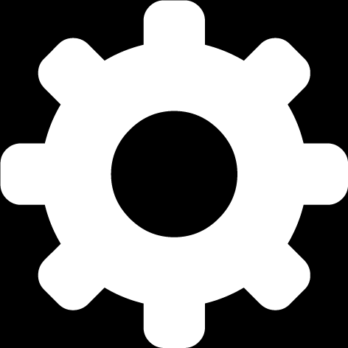
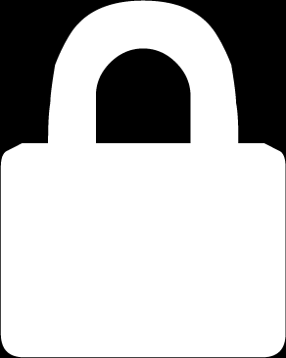

P R E S E N T S T A T U S
This letterhead design is meant to project an image of professionalism and reliability. By using simple alignments we have created a very spacious feeling. The simplicity suggests strength and the spaciousness contributes to the aesthetics of the layout. These basic qualities along with the (Your Company) colors,
HEADTEXT
OF THIS FACT
HEADTEXT
OF THIS FACT
60%
This letterhead design is meant to project an image of professionalism and reliability. By using simple alignments we have.
This letterhead design is meant to project an image of professionalism and reliability. By using simple alignments we have.
2
55%
3
HEADTEXT
OF THIS FACT
HEADTEXT
OF THIS FACT
This letterhead design is meant to project an image of professionalism and reliability. By using simple alignments we have.
42%
This letterhead design is meant to project an image of professionalism and reliability. By using simple alignments we have.
1
30%
4
This letterhead design is meant to project an image of professionalism and reliability. By using simple alignments we have created a very spacious feeling. The simplicity suggests strength and the spaciousness contributes to the aesthetics of the layout. These basic qualities along with the (Your Company) colors, This letterhead design is meant to project an image of professionalism and reliability. By using simple alignments we have created a very spacious feeling. The simplicity suggests strength and the spaciousness contributes.
30

Slide 31



P R E S E N T S T A T U S
This letterhead design is meant to project an image of professionalism and reliability. By using simple alignments we have created a very spacious feeling. The simplicity suggests strength and the spaciousness contributes to the aesthetics of the layout. These basic qualities along with the (Your Company) colors,
10%
25%
45%
75%
90%
65%
Solid Fact Name
Solid Fact Name
Solid Fact Name
Black Fact Name Here
Black Fact Name Here
Black Fact Name Here
HEADTEXT OF THIS FACT
HEADTEXT OF THIS FACT
HEADTEXT OF THIS FACT
This letterhead design is meant to project andon image of professionalism and reliability. By using simple alignments we have.
This letterhead design is meant to project andon image of professionalism and reliability. By using simple alignments we have.
This letterhead design is meant to project andon image of professionalism and reliability. By using simple alignments we have.
31

Slide 32
P R E S E N T S T A T U S
This letterhead design is meant to project an image of professionalism and reliability. By using simple alignments we have created a very spacious feeling. The simplicity suggests strength and the spaciousness contributes to the aesthetics of the layout. These basic qualities along with the (Your Company) colors,
This letterhead design is meant to project an image of professional and reliability. By using alignments we have created a very spacious feel. The simplicity suggests stringed and the spaciousness contributes.
Yes!
WE HAVE
DONE IT
76%
HEADTEXT OF THIS FACT
No!
WE HAVE
LOST IT
24%
HEADTEXT OF THIS FACT
This letterhead design is meant to project an image of professional and reliability. By using alignments we have created a very spacious feel. The simplicity suggests stringed and the spaciousness contributes.
32

Slide 33
P R E S E N T S T A T U S
Extra HEADING FOR THIS TEXT AS EXAMPLE
This letterhead design is meant to project an image of professionalism and reliability. By using simple alignments we have created a very spacious feeling. The simplicity suggests strength.
This letterhead design is meant to project an image of professionalism and reliability. By using simple alignments we have created a very spacious feeling. The simplicity suggests strength and the spaciousnes contributes to the aesthetics of the layout. These basic qualities along with the (Your Company) colours, are consistent with the overall look and helps to reinforce the brand.
This letterhead design is meant to project an image of professionalism and reliability. By using simple alignments we have created a very spacious feeling. The simplicity suggests strength and the spaciousness contributes to the aesthetics of the layout. These basic qualities along with the (Your Company) colors,
33

Slide 34
This letterhead design is meant to project an image of professionalism and reliability. By using simple alignments we have created.
P L A N
F O R C O M P A N Y
F U T U R E
This letterhead design is meant to project an image of professionalism and reliability. By using simple alignments we have created a very spacious feeling. The simplicity suggests strength and the spaciousnes contributes to the aesthetics of the layout. These basic qualities along with the (Your Company) colours, are consistent.
34

Slide 35
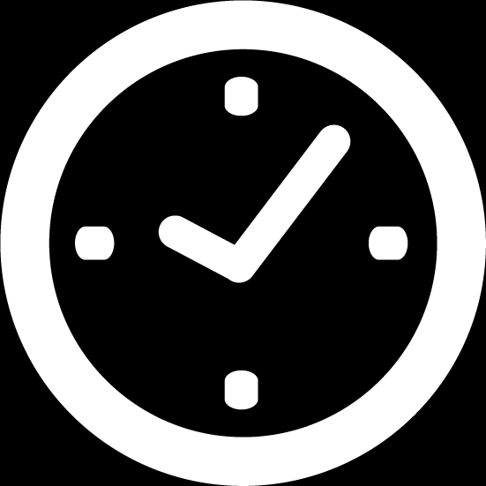

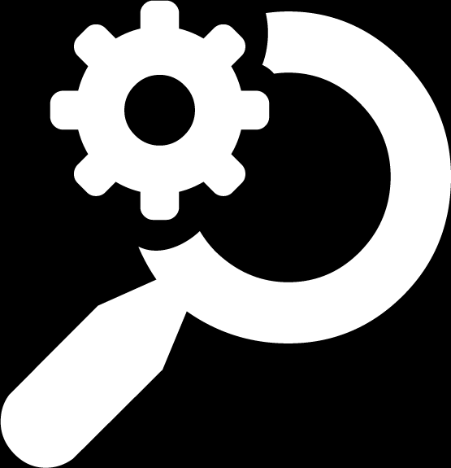

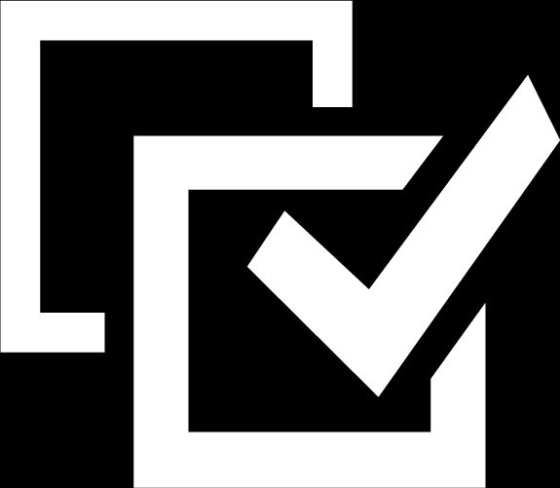
F U T U R E P L A N
This letterhead design is meant to project an image of professionalism and reliability. By using simple alignments we have created a very spacious feeling. The simplicity suggests strength and the spaciousness contributes to the aesthetics of the layout. These basic qualities along with the (Your Company) colors,
Four
STEPS
PLAN
HEADTEXT OF THIS FACT
HEADTEXT OF THIS FACT
This letterhead design meant to project andon image of professional.
This letterhead design meant to project andon image of professional.
HEADTEXT OF THIS FACT
HEADTEXT OF THIS FACT
This letterhead design meant to project andon image of professional.
This letterhead design meant to project andon image of professional.
35

Slide 36
F U T U R E P L A N
This letterhead design is meant to project an image of professionalism and reliability. By using simple alignments we have created a very spacious feeling. The simplicity suggests strength and the spaciousness contributes to the aesthetics of the layout. These basic qualities along with the (Your Company) colors,
contributes to the aesthetics of the layout These basic qualities along with the colours, are consistent the aesthetic.
This letterhead design is meant to project an image of professionalism and reliability. By using simple alignments we have created a very spacious feeling. The simplicity suggests strength and the spaciousness.
This letterhead design is meant to project an image of professionalism and reliability. By using simple alignments we have created a very spacious feeling. The simplicity suggests strength and the spaciousnes contributes to the aesthetics of the layout. These basic qualities along with the (Your Company) colours, are consistent with the overall look and helps to reinforce the (Your Company) brand. This letterhead design is meant to project an image of professionalism and reliability. This letterhead design is meant to project an image of professionalism and reliability. By using simple alignments we have created a very spacious feeling. The simplicity suggests strength and the spaciousnes contributes to the aesthetics of the layout.
36

Slide 37
F U T U R E P L A N
This letterhead design is meant to project an image of professionalism and reliability. By using simple alignments we have created a very spacious feeling. The simplicity suggests strength and the spaciousness contributes to the aesthetics of the layout. These basic qualities along with the (Your Company) colors,
contributes to the aesthetics of the layout These basic qualities along with the colors,
8%
This letterhead design is meant to project an image of professionalism and reliability. By using simple alignments we have created a very spacious feeling.
Example
HEADTEXT FACT
66%
Example
HEADTEXT FACT
12%
This letterhead design is meant to project an image of professionalism and reliability. By using simple alignments we have created a very spacious feeling.
This letterhead design is meant to project an image of professionalism and reliability. By using simple alignments we have created a very.
Example
HEADTEXT FACT
37

Slide 38

F U T U R E P L A N
Letterhead design meant project image of professionalism.
This letterhead design is meant to project an image of professionalism and reliability. By using simple alignments we have created a very spacious feeling.
1
This letterhead design is meant project an image of professional and reliability. By using simple.
1
This letterhead design is meant project an image of professional and reliability. By using simple.
2
This letterhead design is meant project an image of professional and reliability. By using simple.
2
This letterhead design is meant project an image of professional and reliability. By using simple.
38

Slide 39
H A V E A
C O F F E E B R E A K
We
BACK IN
10
This letterhead design is meant to project an image of professionalism and reliability. By using simple alignments we have created.
Minutes
39

Slide 40
M O R E
I N F O G R A P H I C
This letterhead design is meant to project an image of professionalism and reliability. By using simple alignments.
This letterhead design is meant to project an image of professionalism and reliability. By using simple alignments we have created a very spacious feeling. The simplicity suggests strength and the spaciousnes contributes to the aesthetics of the layout. These basic qualities along.
40

Slide 41
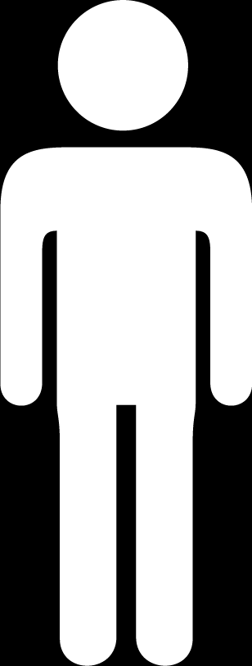
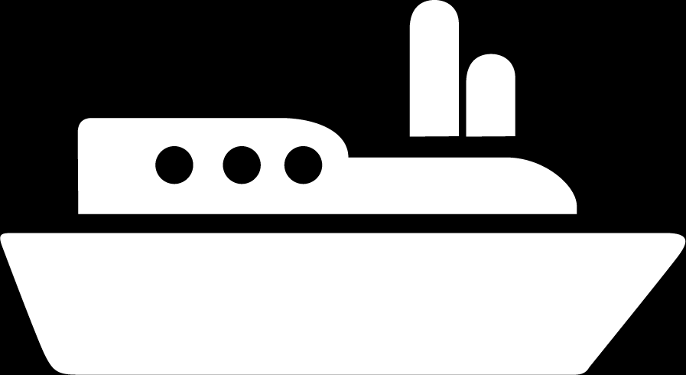
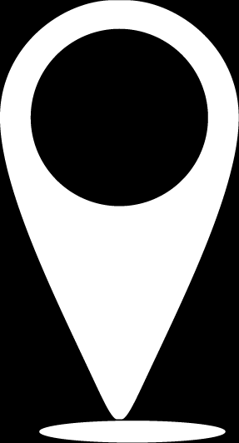
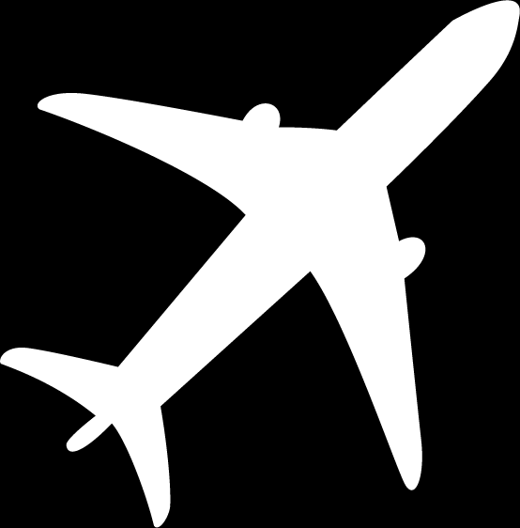
I N F O G R A P H I C 1
This letterhead design is meant to project an image of professionalism and reliability. By using simple alignments we have created a very spacious feeling. The simplicity suggests strength and the spaciousness contributes to the aesthetics of the layout. These basic qualities along with the (Your Company) colors,
HEADTEXT
OF THIS FACT
HEADTEXT
OF THIS FACT
14%
This letterhead design is meant to project an image of professional and reliability by using simple.
30%
This letterhead design is meant to project an image of professional and reliability by using simple.
HEADTEXT
OF THIS FACT
HEADTEXT
OF THIS FACT
8%
This letterhead design is meant to project an image of professional and reliability by using simple.
21%
This letterhead design is meant to project an image of professional and reliability by using simple.
Extra HEADING FOR THIS TEXT AS EXAMPLE
41

Slide 42
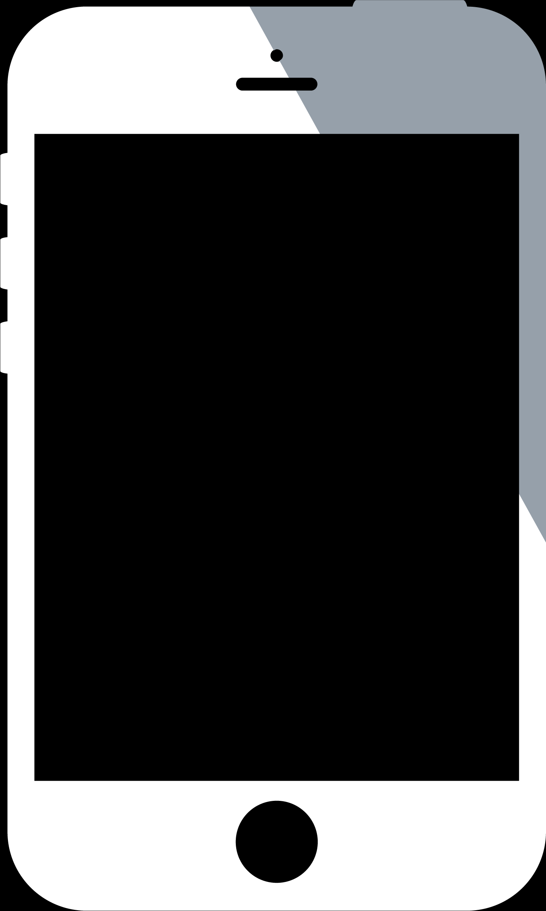
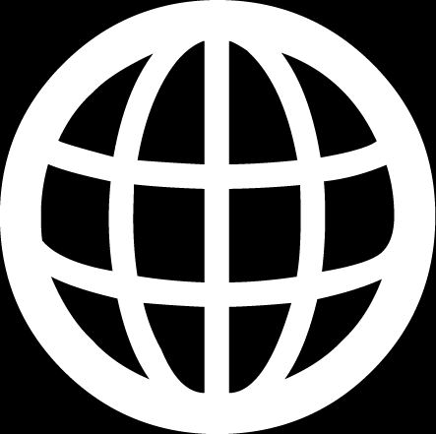
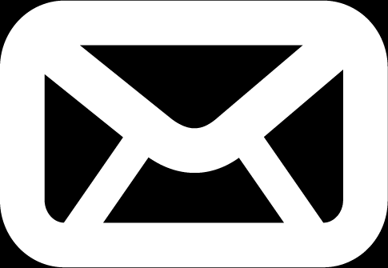
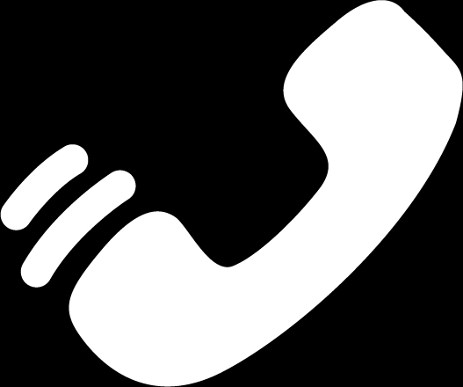
I N F O G R A P H I C 2
This letterhead design is meant to project an image of professionalism and reliability. By using simple alignments we have created a very spacious feeling. The simplicity suggests strength and the spaciousness contributes to the aesthetics of the layout. These basic qualities along with the (Your Company) colors,
This letterhead design is meant to project an image of professionalism
01
This letterhead design is meant to project an image of professionalism and reliability. By using simple alignments .
Spacious contributes to the aesthetics of the layout. These basic qualities along with the (Your Company) colors, are consistent with the overall look and helps to reinforce the (Your Company) brand. This letterhead design is meant to project an image of professionalism and reliability. This letterhead design is meant to project an image of professionalism and reliability. By using simple alignments we have created a very spacious feeling.
Online
02
This letterhead design is meant to project an image of professionalism and reliability. By using simple alignments .
Ofline SMS
03
This letterhead design is meant to project an image of professionalism and reliability. By using simple alignments .
Ofline Calling
42

Slide 43

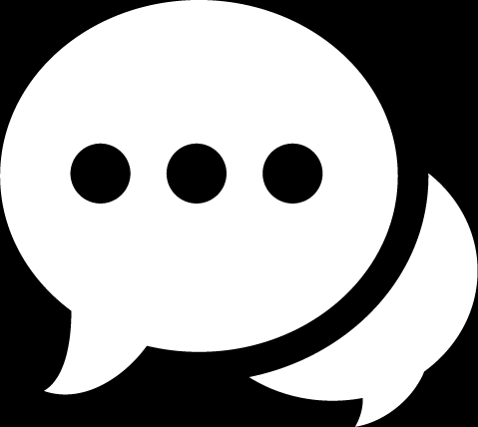
I N F O G R A P H I C 3
This letterhead design is meant to project an image of professionalism and reliability. By using simple alignments we have created a very spacious feeling. The simplicity suggests strength and the spaciousness contributes to the aesthetics of the layout. These basic qualities along.
HEADTEXT HARE
This letterhead design is meant project an image of professional and reliability by using simple.
With the overall
look and helps to reinforce
HEADING TWO
With the overall look and helps to reinforce the (Your Company) brand. This letterhead design is meant to project an image of professionalism and reliability. This letterhead design is meant to project an image.
This letterhead design is meant project an image of professional and reliability by using simple.
THIRD HEAD HARE
This letterhead design is meant project an image of professional and reliability by using simple.
43

Slide 44
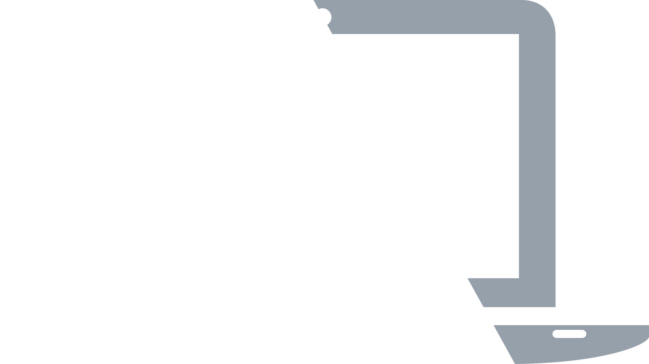
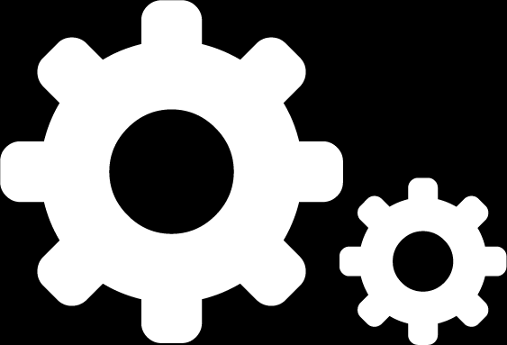
I N F O G R A P H I C 4
This letterhead design is meant to project an image of professionalism and reliability. By using simple alignments we have created a very spacious feeling. The simplicity suggests strength and the spaciousness contributes to the aesthetics of the layout. These basic qualities along with the (Your Company) colors,
This letterhead design is meant to project an image of professionalism and reliability. By using simple alignments we have created a very spacious feeling. The simplicity suggests strength and the spaciousness contributes to the aesthetics of the layout. These basic qualities along with the (Your Company) colors,
With the overall
look and helps to reinforce
MAC
Windows
OS
Linux
Blackberry
45%
55%
58%
75%
60%
This letterhead design is meant to project an image of professional and reliability.
44

Slide 45
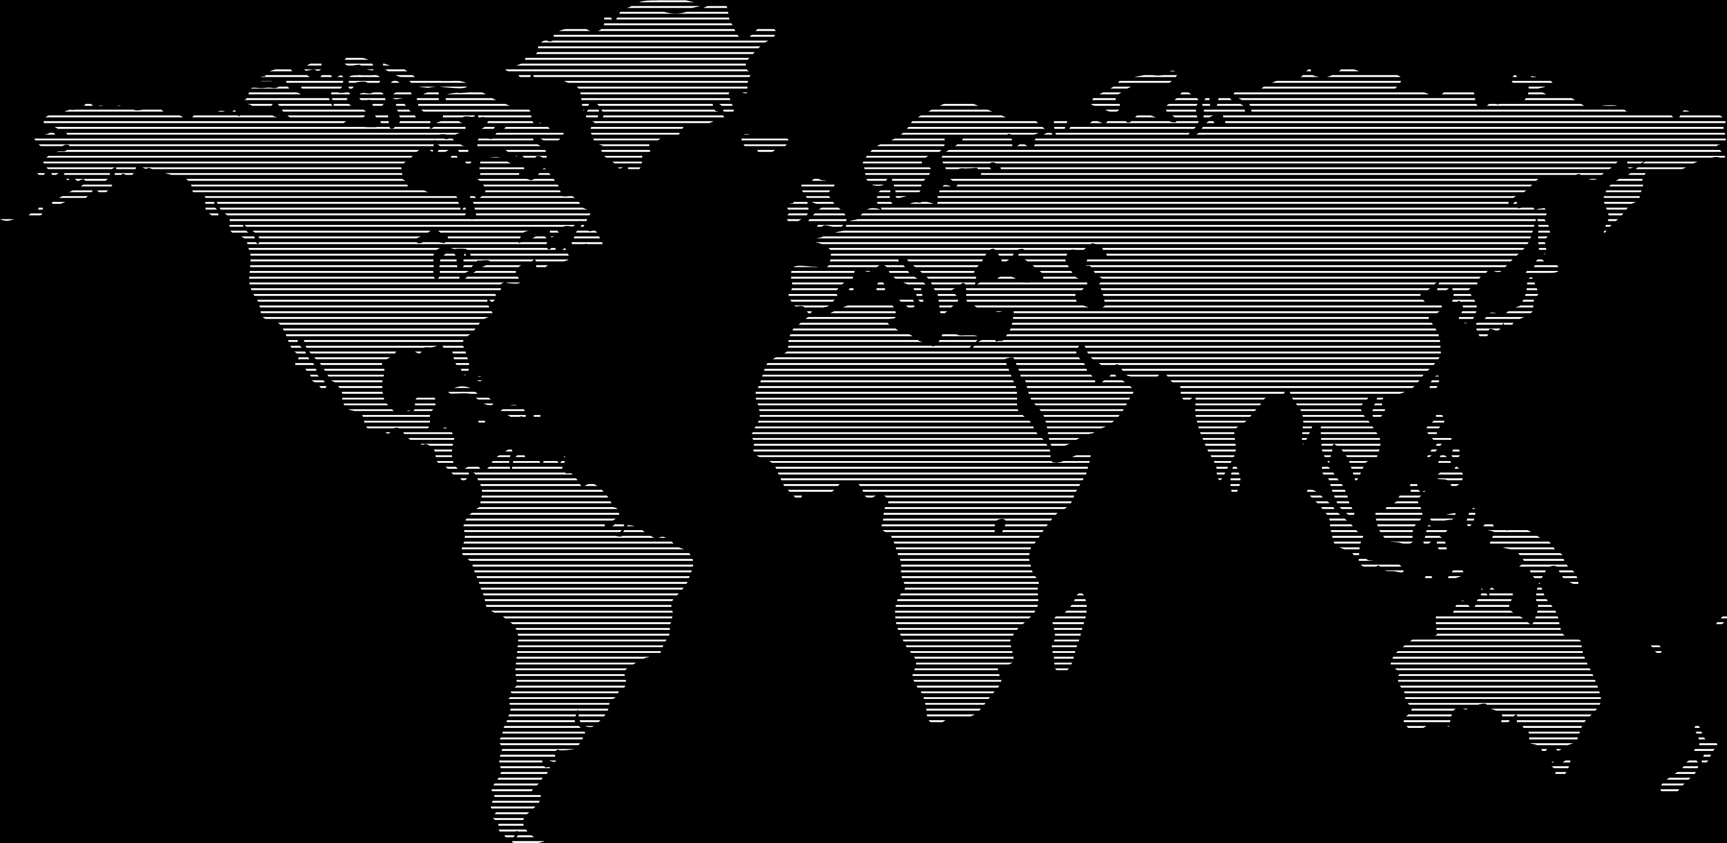
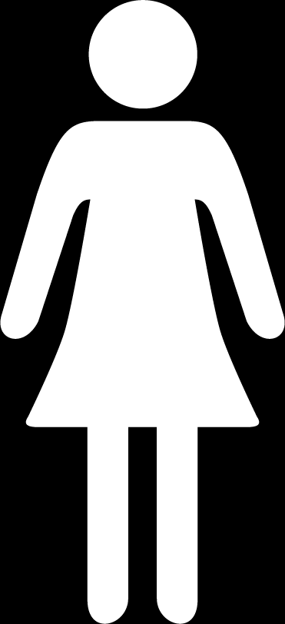
HEADING TEXT THIS FACT
I N F O G R A P H I C 5
HEADING TEXT THIS FACT
HEADING TEXT THIS FACT
This letterhead design is meant to project an image of professionalism and reliability. By using simple alignments we have created a very spacious feeling. The simplicity suggests strength and the spaciousness contributes to the aesthetics of the layout. These basic qualities along with.
HEADING TEXT THIS FACT
This letterhead design is meant to project an image of professionalism and reliability. By using simple alignments we have created a very spacious feeling. The simplicity suggests strength and the spaciousness contributes to the aesthetics of the layout. These basic qualities along with the (Your Company) colors,
HEADING ONE
SECOND TITLE
THIRD HEAD
THIS IS FOUR
This letterhead design is meant project an image of professional and reliability by using simple.
This letterhead design is meant project an image of professional and reliability by using simple.
This letterhead design is meant project an image of professional and reliability by using simple.
This letterhead design is meant project an image of professional and reliability by using simple.
45

Slide 46
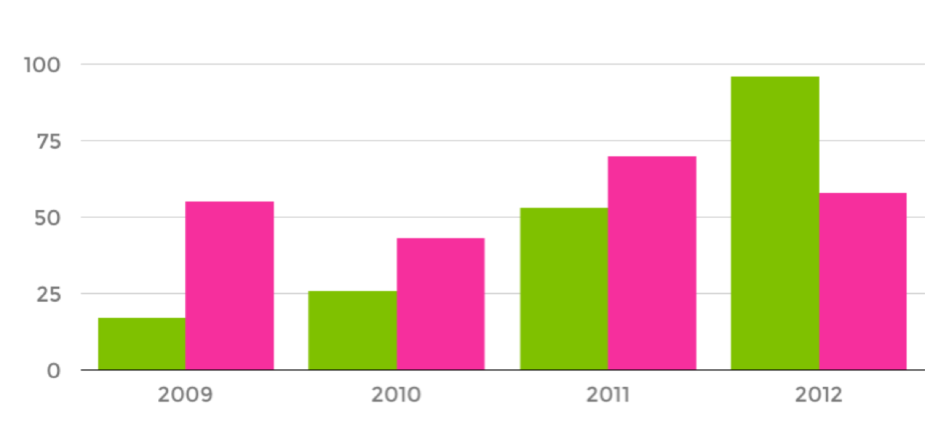
I N F O G R A P H I C 6
This letterhead design is meant to project an image of professionalism and reliability. By using simple alignments we have created a very spacious feeling. The simplicity suggests strength and the spaciousness contributes to the aesthetics of the layout. These basic qualities along with the (Your Company) colors,
Solid Fact Name
HEADING TEXT GOES HERE
35
This letterhead design is meant to project an image of professionalism and reliability. By using simple alignments we have created.
Black Fact Name Here
This letterhead design is meant to project an image of professionalism this letterhead design
HEADING TEXT GOES HERE
18
This letterhead design is meant to project an image of professionalism and reliability. By using simple alignments we have created.
Spacious contributes to the aesthetics of the layout. These basic qualities along with the (Your Company) colors, are consistent with the overall look and helps to reinforce the (Your Company) brand. This letterhead design is meant.
46

Slide 47
I N F O G R A P H I C 7
This letterhead design is meant to project an image of professionalism and reliability. By using simple alignments we have created a very spacious feeling. The simplicity suggests strength and the spaciousness contributes to the aesthetics of the layout. These basic qualities along with the (Your Company) colors,
Quiut fastidii dignis vero offendit apeiria eaquo vimne tritan.
8%
7%
Quiut fastidii dignis vero offendit apeiria eaquo vimne tritan.
4%
Quiut fastidii dignis vero offendit apeiria eaquo vimne tritan.
40%
28%
Quiut fastidii dignis vero offendit apeiria eaquo vimne tritan.
18%
25%
Quiut fastidii dignis vero offendit apeiria eaquo vimne tritan.
Quiut fastidii dignis vero offendit apeiria eaquo vimne tritan.
Extra HEADING FOR THIS TEXT AS EXAMPLE
This letterhead design is meant to project an image of professionalism and reliability. By using simple alignments we have created a very spacious feeling. The simplicity suggests strength and the spaciousness contributes.
47

Slide 48
M A R K E T I N G
K E Y S & R E P O R T S
This letterhead design is meant to project an image of professionalism and reliability. By using simple alignments we have created a very spacious feeling. The simplicity suggests strength and the spaciousnes contributes to the aesthetics of the layout. These basic qualities along.
48

Slide 49
M A R K E T I N G K E Y S & R E P O R T S
This letterhead design is meant to project an image of professionalism and reliability. By using simple alignments we have created a very spacious feeling. The simplicity suggests strength and the spaciousness contributes to the aesthetics of the layout. These basic qualities along with the (Your Company) colors,
1
This letterhead design is meant project an image of professional and reliability. By using simple.
This letterhead design is meant to project an image of professionalism and reliability. By using simple alignments we have created a very spacious feeling. The simplicity suggests strength and the spaciousness contributes to the aesthetics of the layout. These basic qualities along with.
This letterhead design is meant to project an image of professionalism and reliability. By using simple alignments .
2
This letterhead design is meant project an image of professional and reliability. By using simple.
3
This letterhead design is meant project an image of professional and reliability. By using simple.
Extra HEADING FOR THIS TEXT AS EXAMPLE
4
This letterhead design is meant project an image of professional and reliability. By using simple.
5
This letterhead design is meant project an image of professional and reliability. By using simple.
49

Slide 50
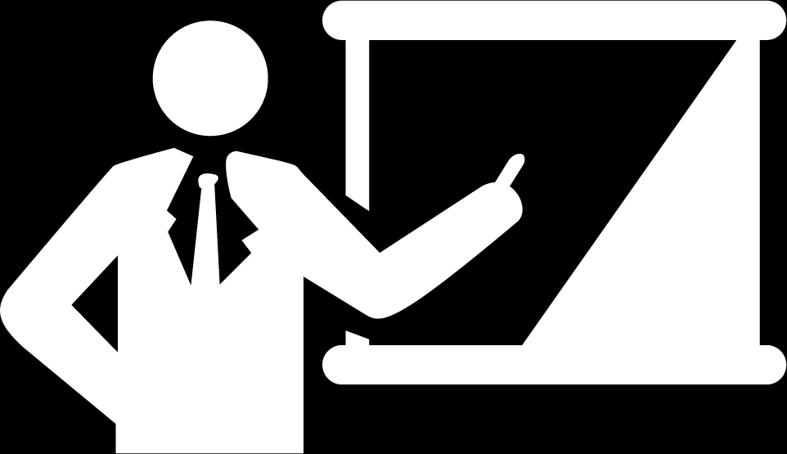
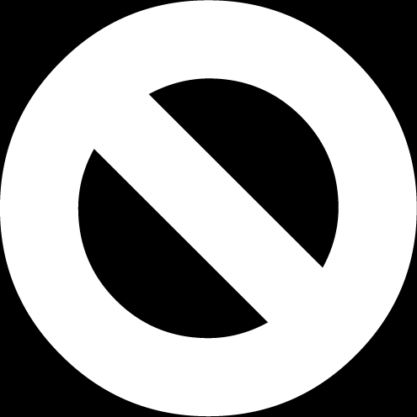
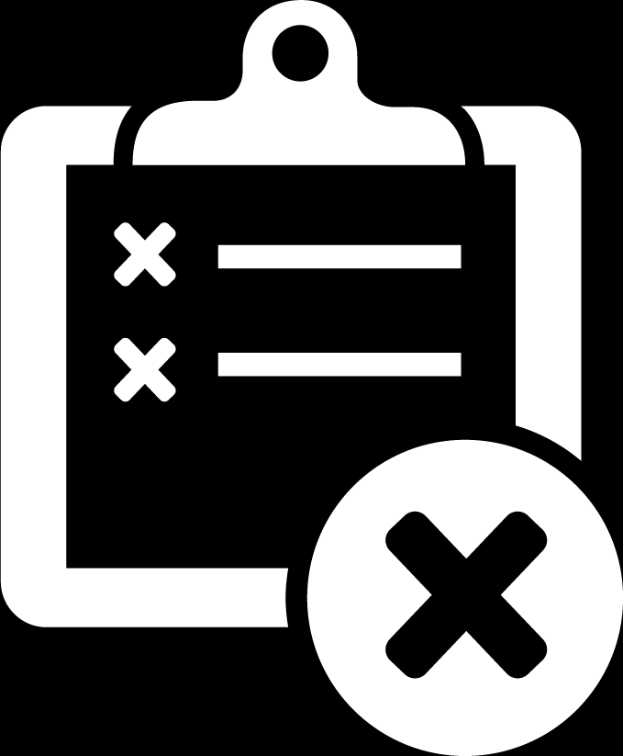




M A R K E T I N G K E Y S & R E P O R T S
This letterhead design is meant to project an image of professionalism and reliability. By using simple alignments we have created a very spacious feeling. The simplicity suggests strength and the spaciousness contributes to the aesthetics of the layout. These basic qualities along with the (Your Company) colors,
Extra HEADING FOR THIS TEXTS
HEADTEXT
OF THIS FACT
HEADTEXT
OF THIS FACT
This letterhead design is meant to project an image of professionalism and reliability. By using simple alignments we have created a very spacious feeling. The simplicity suggests strength and the spaciousness contributes to the of the layout. These basic qualities along with the (Your Company) colors,
HEADTEXT
THIS FACT
HEADTEXT
OF THIS FACT
HEADTEXT THIS FACT
This letterhead design is meant to project an image of professional.
This letterhead design is meant to project an image of professionalism and reliability.
HEADTEXT
THIS FACT
HEADTEXT
THIS FACT
50

Slide 51



M A R K E T I N G K E Y S & R E P O R T S
This letterhead design is meant to project an image of professionalism and reliability. By using simple alignments we have created a very spacious feeling. The simplicity suggests strength and the spaciousness contributes to the aesthetics of the layout. These basic qualities along with the (Your Company) colors,
10%
25%
45%
75%
90%
65%
75/25%
90/10%
65/35%
Extra HEADING FOR THIS
TEXT AS EXAMPLE
Extra HEADING FOR THIS
TEXT AS EXAMPLE
Extra HEADING FOR THIS
TEXT AS EXAMPLE
This letterhead design is meant to project an image of professionalism and reliability. By using simple alignments we have created a very spacious feeling. The simplicity suggests strength and the spaciousness contributes.
This letterhead design is meant to project an image of professionalism and reliability. By using simple alignments we have created a very spacious feeling. The simplicity suggests strength and the spaciousness contributes.
This letterhead design is meant to project an image of professionalism and reliability. By using simple alignments we have created a very spacious feeling. The simplicity suggests strength and the spaciousness contributes.
51

Slide 52
M A R K E T I N G K E Y S & R E P O R T S
Extra HEADING FOR THIS TEXTS
75
25%
This letterhead design is meant to project an image of professionalism and reliability. By using simple alignments we have created a very spacious feeling. The simplicity suggests strength and the spaciousness contributes to the of the layout. These basic qualities along with the (Your Company) colors,
This letterhead design is meant to project an image of professionalism this letterhead design this letterhead design is meant
This letterhead design is meant to project an image of professional.
Spacious contributes to the aesthetics of the layout. These basic qualities along with the (Your Company) colors, are consistent with the overall look and helps to reinforce the (Your Company) brand. This letterhead design is meant. Spacious contributes to the aesthetics of the layout. These basic qualities along with the (Your Company) colors, are consistent with the overall look and helps to reinforce the (Your Company) brand. This letterhead design is meant.
52

Slide 53




O U R
A C H I E V E M E N T
This letterhead design is meant to project an image of professionalism and reliability. By using simple alignments we have created a very spacious feeling. The simplicity suggests strength and the spaciousnes contributes to the aesthetics of the layout. These basic qualities along.
Extra HEADING FOR THIS
TEXT AS EXAMPLE
Extra HEADING FOR THIS
TEXT AS EXAMPLE
Extra HEADING FOR THIS
TEXT AS EXAMPLE
Extra HEADING FOR THIS
TEXT AS EXAMPLE
This letterhead design is meant to project an image of professionalism and reliability. By using simple alignments.
This letterhead design is meant to project an image of professionalism and reliability. By using simple alignments.
This letterhead design is meant to project an image of professionalism and reliability. By using simple alignments.
This letterhead design is meant to project an image of professionalism and reliability. By using simple alignments.
53

Slide 54

A C H I E V E M E N T
This letterhead design is meant to project an image of professionalism and reliability. By using simple alignments we have created a very spacious feeling. The simplicity suggests strength and the spaciousness contributes to the aesthetics of the layout. These basic qualities along with the (Your Company) colors,
Extra HEADING FOR THIS TEXTS AND THIS IS SAMPLE
Extra HEADING FOR THIS
88%
This letterhead design is meant project an image of professional and reliability. By using simple.
1
This letterhead design is meant to project an image of professionalism and reliability. By using simple alignments we have created a very spacious feeling. The simplicity suggests strength.
Extra HEADING FOR THIS
TEXT AS EXAMPLE
This letterhead design is meant project an image of professional and reliability. By using simple.
2
Extra HEADING FOR THIS
02
This letterhead design is meant project an image of professional and reliability. By using simple.
3
Extra HEAD HERE
100%
This letterhead design is meant project an image of professional and reliability. By using simple.
4
Extra HEADING FOR THIS
TEXT AS EXAMPLE
This letterhead design is meant project an image of professional and reliability. By using simple.
5
54

Slide 55
A C H I E V E M E N T
This letterhead design is meant to project an image of professionalism and reliability. By using simple alignments we have created a very spacious feeling. The simplicity suggests strength and the spaciousness contributes to the aesthetics of the layout. These basic qualities along with the (Your Company) colors,
This letterhead design is meant to project an image of professionalism this letterhead design this letterh design is meant
Spacious contributes to the aesthetics of the layout. These basic qualities along with the (Your Company) colors, are consistent with the overall look and helps to reinforce the (Your Company) brand. This letterhead design is meant. Spacious contributes to the aesthetics of the layout. These basic qualities along with the (Your Company) colors, are consistent with the overall look and helps to reinforce the (Your Company) brand. This letterhead design is meant. Spacious contributes to the aesthetics of the layout. These basic qualities along with the (Your Company) colors, are consistent with the overall look and helps to reinforce the (Your Company) brand. This letterhead design is meant. Spacious contributes to the aesthetics of the layout. These basic qualities along with the (Your Company) colors, are consistent with the overall look and helps to reinforce the (Your Company) brand. This letterhead design is meant.
55

Slide 56


L E T ’ S C O N N E C T U S
This letterhead design is meant to project an image of professionalism.
This letterhead design is meant to project an image of professionalism.
This letterhead design is meant to project an image of professionalism.
This letterhead design is meant to project an image of professionalism.
@fbidname
#twtidtext
lkd@nyourid
google+name
56

Slide 57
This letterhead design is meant to project an image of professionalism and reliability. By using simple alignments we have created a very spacious feeling. The simplicity suggests strength.
57

Slide 58
T H A N K S
For Watching & Contributed
Let’s
TALK NOW

